Slide 1
Service Requests for Staff

Slide 2
What is Service Requests for Staff?
Service Requests for Staff is used by staff to respond to the service requests raised by customers through the Self Serve tool (Service Request Creation)
Service Requests for Staff is available to staff users only and cannot be accessed by Customer users (SA or EU)

Slide 3
Setup & Entitlements

Slide 4
Setup & Entitlements
Staff Hexagon
  For staff users, access to the Self Service staff portal is defined at institution level
    Full Self Service for staff entitlement options are only available at either Branch or Institution level (e.g. US/HBUS/ALL or US/HBUS/EBD).
    Country level (e.g. US/ALL/ALL) supports “Enquire” only.
    Self Service is not supported at the Global level (ALL/ALL/ALL)
HSBCnet
  Staff users must be entitled to “Service Requests for Staff” in order to access the Self Service staff tool.

Slide 5
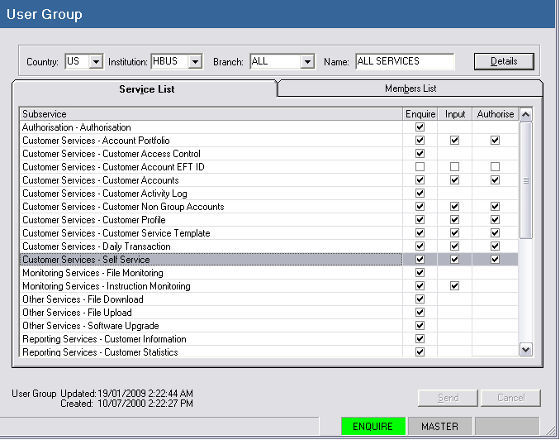
Staff Hex Screenshot – Staff Services → User Group
Full Self Service for staff entitlement options are only available at either Branch or Institution level

Slide 6
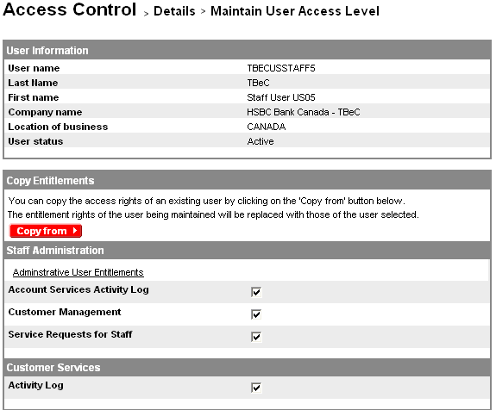
HSBCnet Screenshot
“Service Requests for Staff” will allow staff to access the Staff Self Service tool

Slide 7
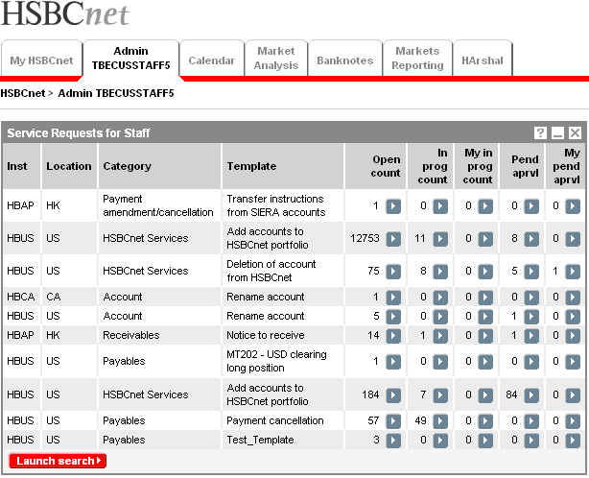
HSBCnet Screenshot – Service Requests for Staff
The “Service Requests for Staff” tool will be added to the “Admin” tab by default

Slide 8
How Does It Work?

Slide 9
How Does It Work?
The “Service Requests for Staff” tool is used by staff to respond to the service requests submitted by HSBCnet Customers
The tool displays all the different service categories and templates which the staff user is entitled to view.
  Staff User entitlement is defined in Staff Hex
The service request counts are sorted by status:
  Open count
    Indicates the number of service requests currently “open”. All newly created service requests are placed in this status
  In prog count
    Indicates the total number of service requests which staff have placed in the “In Progress” status

Slide 10
How Does It Work?
Statuses (cont…)
  My in prog count
    User level status which indicates the number of service requests the current staff user has placed in the “In Progress” status
  Pend aprvl
    Indicates the total number of service requests pending approval
  My pend aprvl
    User level status which indicates the number of service requests the current staff user has modified and is pending approval of another staff user

Slide 11
HSBCnet Screenshot – Service Requests for Staff
Each service request category/template is separated by country and institution in to different rows with instruction counts for each status
Search option is available to search for specific service requests

Slide 12
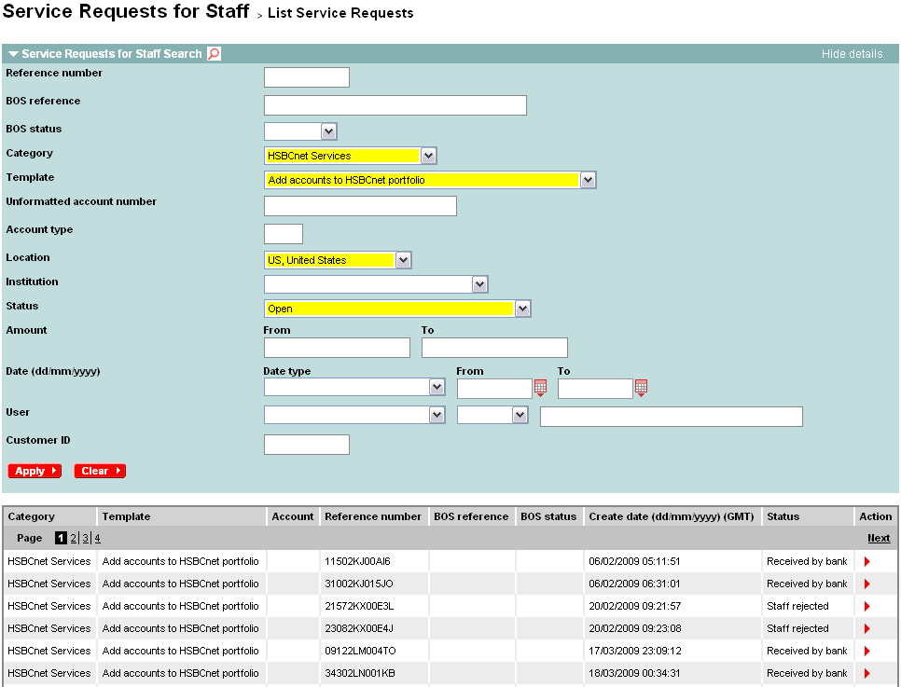
Service Requests for Staff – “Launch Search” screen
Use the search filter to limit the number of service requests displayed on screen
Results are displayed below

Slide 13
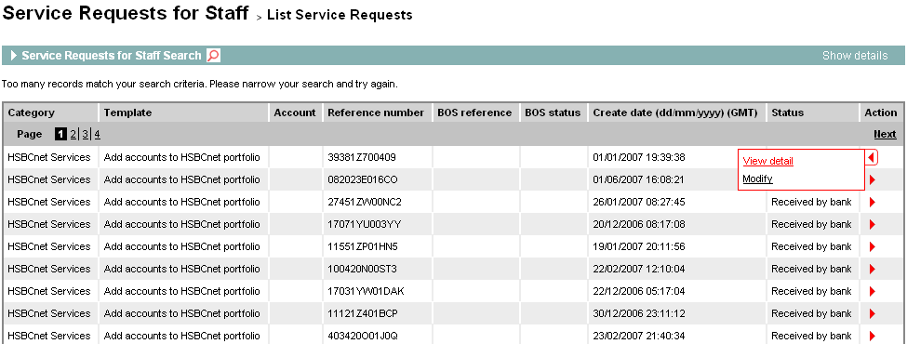
Service Requests for Staff – “Launch Search” screen
To view the details of a service request, mouse-over the arrow under the action column and click “View detail”

Slide 14
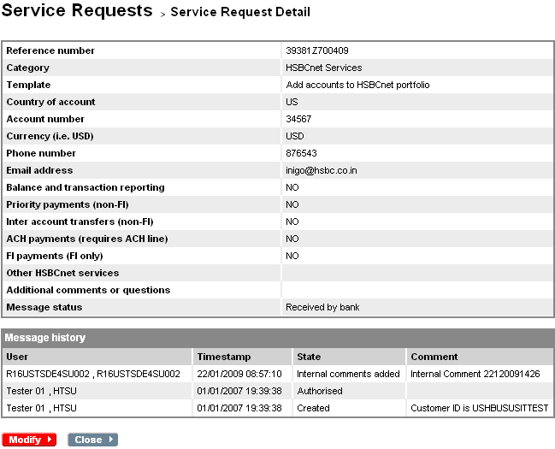
Service Requests for Staff – Service Request Detail

Slide 15
How Does It Work?
– Modify a service request –

Slide 16
Service Requests for Staff – Service Request Detail
Click “Modify” to make changes to the service request

Slide 17
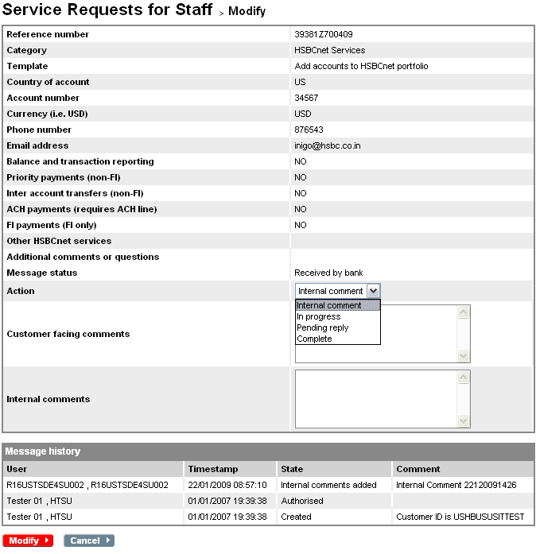
Service Requests for Staff – Modify
Use the drop-down list to select an “Action”

Slide 18
Action Statuses
Internal Comment
  Allows staff user to enter comments and additional information via the “Internal Comments” text box which will be visible to other staff users only.
  Modifying service requests with internal comments does not require authorisation from another staff user.
In Progress
  This action will update the status of the service request to “In Progress”. This will update the customer view of the message history immediately.
  This modification action does not require authorisation from another staff user

Slide 19
Action Statuses
Pending Reply
  Used when staff need to enter comments into the “Customer facing comments” text box
  Modifying service requests with “Pending reply” will require authorisation from another staff user before the changes are saved and applied.
  When authorised, the service request is removed from staff view until the customer replies
Complete
  Used to “close” a service request.
  Selecting this action status will allow staff to enter comments into the “Customer facing comments” text box only.
  Modifying service requests with “Complete” will require authorisation from another staff user before the changes are saved and applied.

Slide 20
How Does It Work?
– Modify with “Internal Comment” –

Slide 21
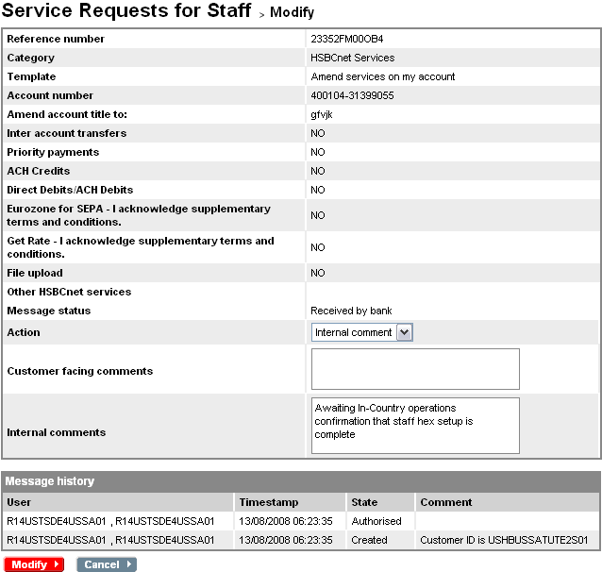
Service Requests for Staff – Modify (Internal Comment)
Select “Internal comment” from the drop-down list. And enter text into the “Internal Comments” box. (“Customer facing comments” text box is disabled)
Click “Modify” to submit the modifications made to the service request

Slide 22
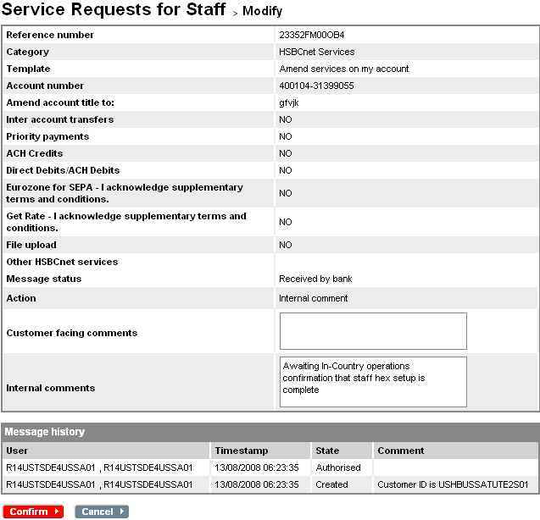
Service Requests for Staff – Modify (Internal Comment)
After verifying the modifications made, click “Confirm” to proceed.

Slide 23
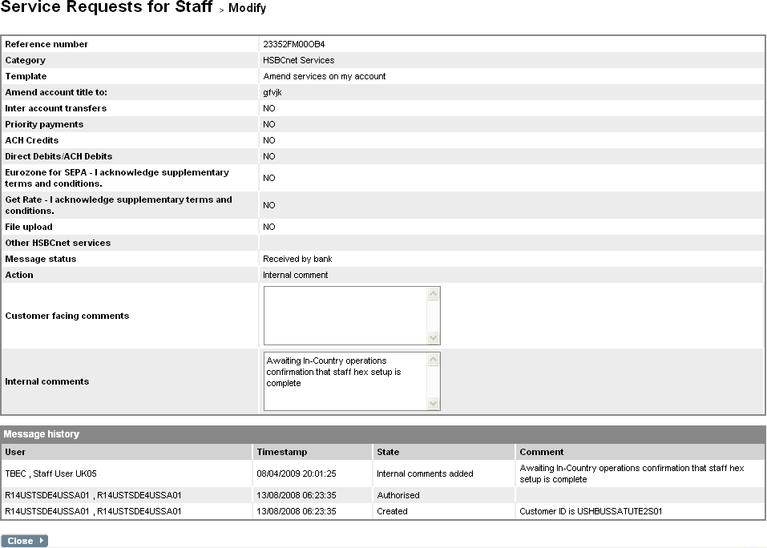
Service Requests for Staff – Modify (Internal Comment)
Once confirmed, the “Message history” will be updated with the newly added internal comments. Authorisation from another staff user is not required

Slide 24
How Does It Work?
– Modify with “In Progress” –

Slide 25
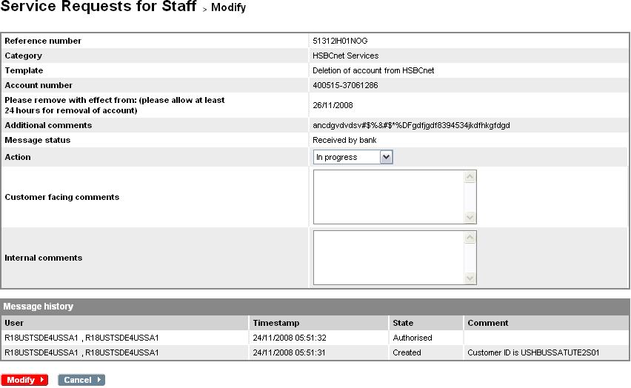
Service Requests for Staff – Modify (In Progress)
When “In Progress” is selected from the drop-down list, both “Customer facing comments” and “Internal comments” text boxes are disabled
Click “Modify” to submit the modifications made to the service request

Slide 26
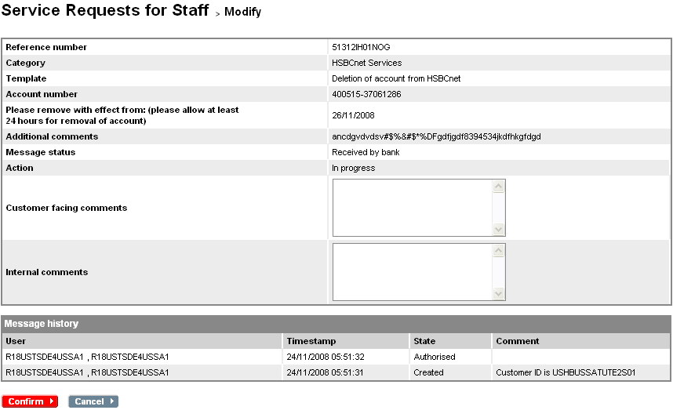
Service Requests for Staff – Modify (In Progress)
After verifying the modifications made, click “Confirm” to proceed.

Slide 27
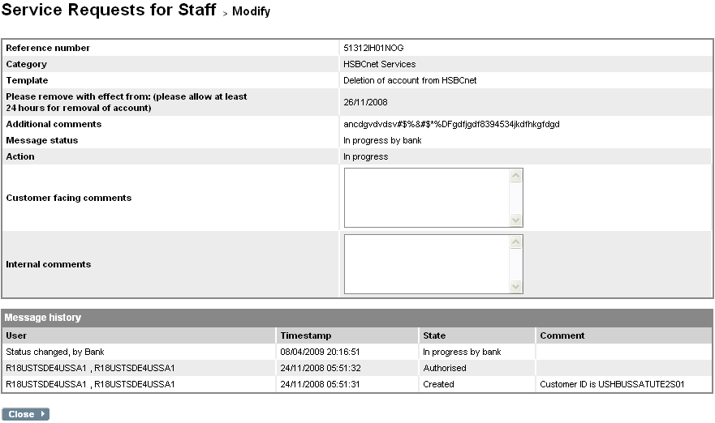
Service Requests for Staff – Modify (In Progress)
Once confirmed, the “Message history” will be updated with the new status of “In progress by bank”. This will also update the customer view of this service request immediately

Slide 28
How Does It Work?
– Modify with “Pending reply” –

Slide 29
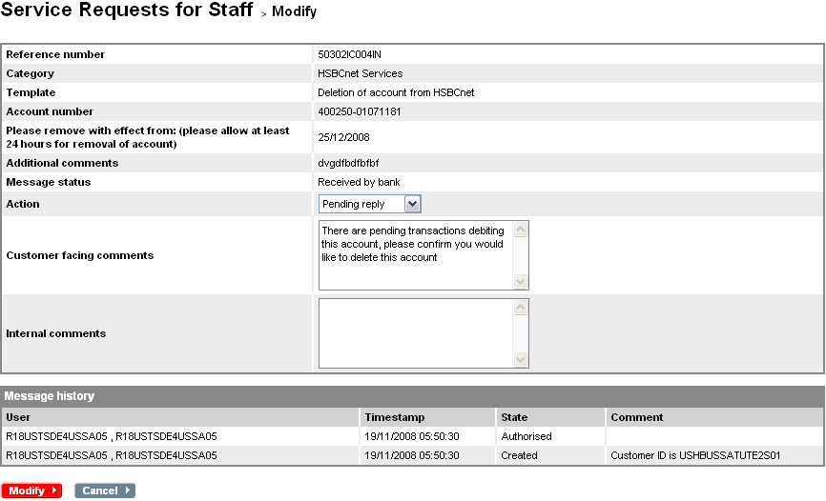
Service Requests for Staff – Modify (Pending Reply)
Select “Pending reply” from the drop-down list. And enter text into the “Customer facing comments” text box. (“Internal comments” text box is disabled)
Click “Modify” to submit the modifications made to the service request

Slide 30
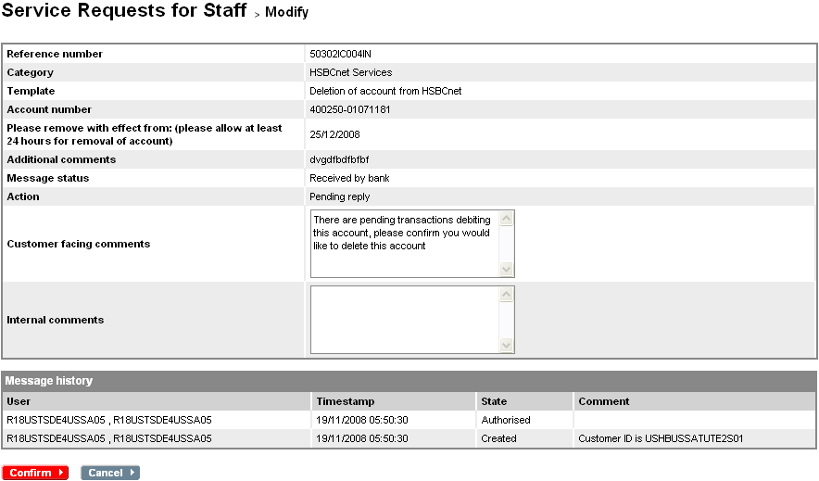
Service Requests for Staff – Modify (Pending Reply)
After verifying the modifications made, click “Confirm” to proceed.

Slide 31
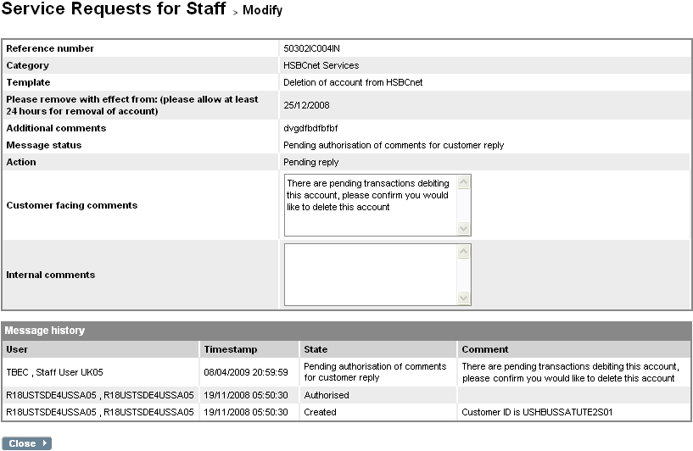
Service Requests for Staff – Modify (Pending Reply)
Once confirmed, the “Message history” will be updated with the new status of “Pending authorisation of comments for customer reply”. Authorisation of another staff user is required before the modifications are applied and the customer is able to see the comments entered

Slide 32
How Does It Work?
– Modify with “Complete” –

Slide 33
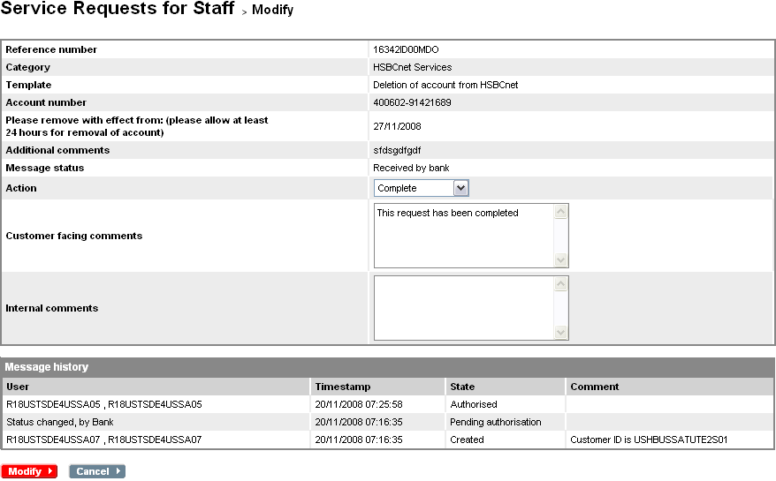
Service Requests for Staff – Modify (Complete)
Select “Complete” from the drop-down list. And enter any comments into the “Customer facing comments” text box. (“Internal comments” text box is disabled)
Click “Modify” to submit the modifications made to the service request

Slide 34
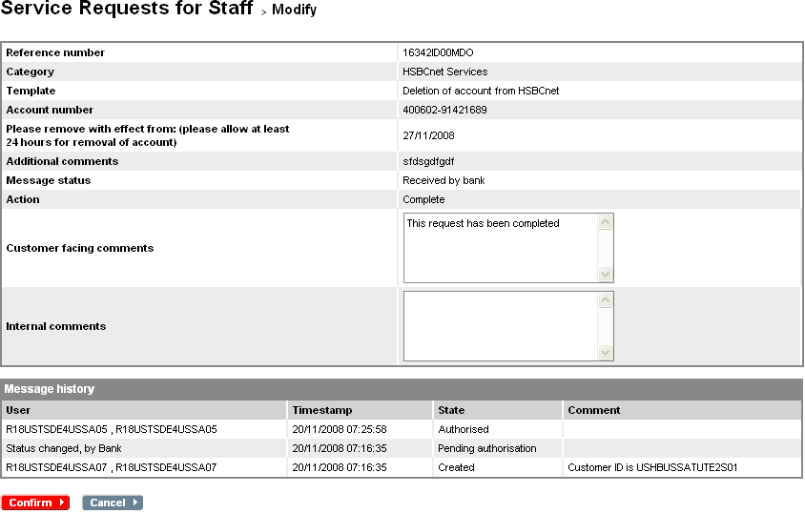
Service Requests for Staff – Modify (Complete)
After verifying the modifications made, click “Confirm” to proceed.

Slide 35
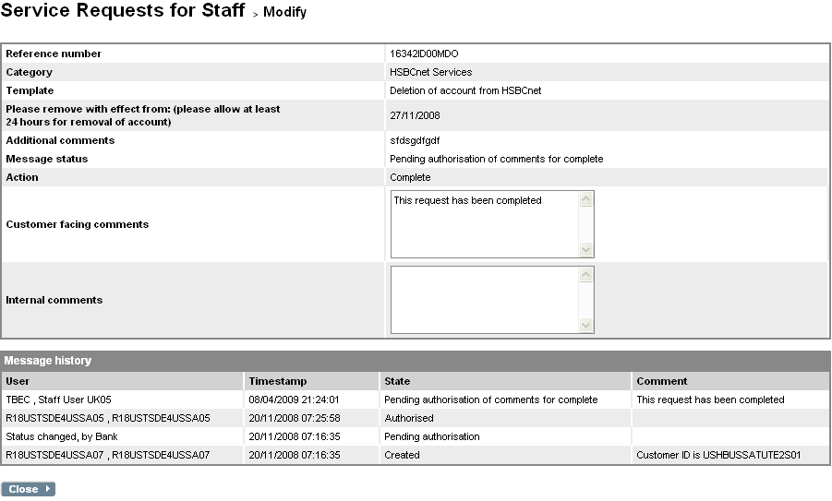
Service Requests for Staff – Modify (Complete)
Once confirmed, the “Message history” will be updated with the new status of “Pending authorisation of comments for complete”. Authorisation of another staff user is required before the modifications are applied and the customer is able to see the comments entered

Slide 36
How Does It Work?
– Authorise Staff Modifications –

Slide 37
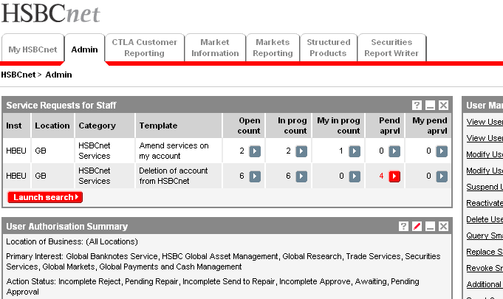
Service Requests for Staff
To authorise service request modifications made by staff, click the action arrow under the “Pend aprvl” column next to the service Category/Template you would like to authorise.

Slide 38
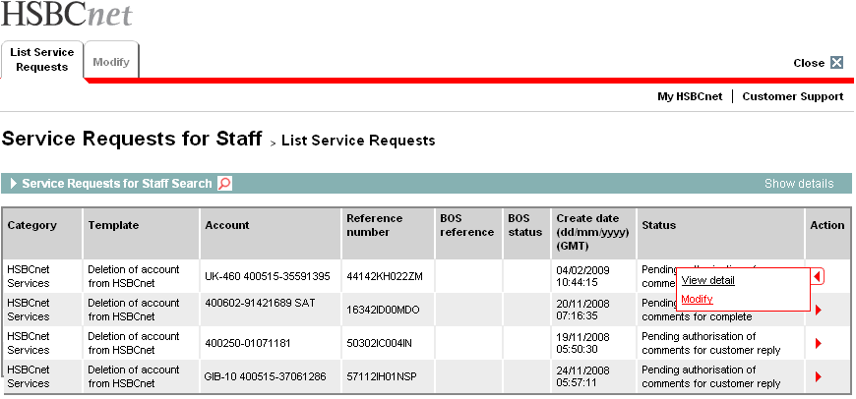
Service Requests for Staff – Pending Approval List
Mouse-over the action arrow and select the “Modify” action option

Slide 39
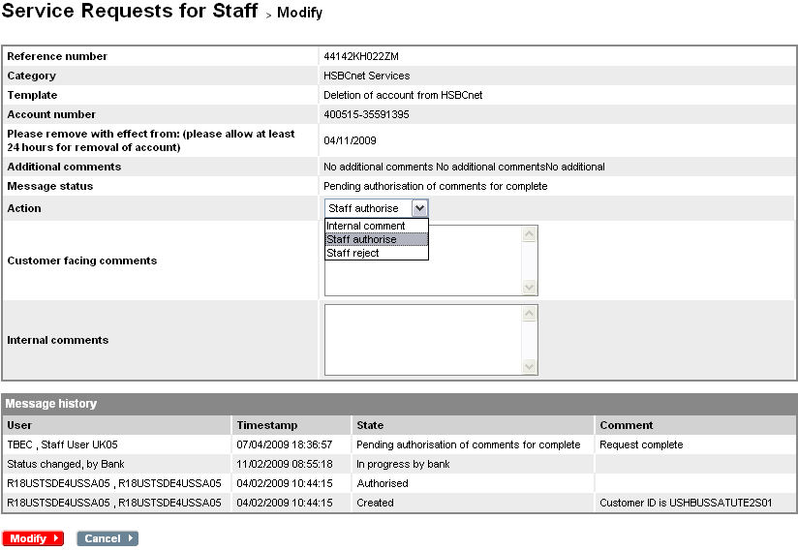
Pending Approval List – Service Request Details
Select “Staff authorise” from the drop-down list.
Options to add internal comments or reject the modification are also available.
After selecting an action, click on “Modify” to continue

Slide 40
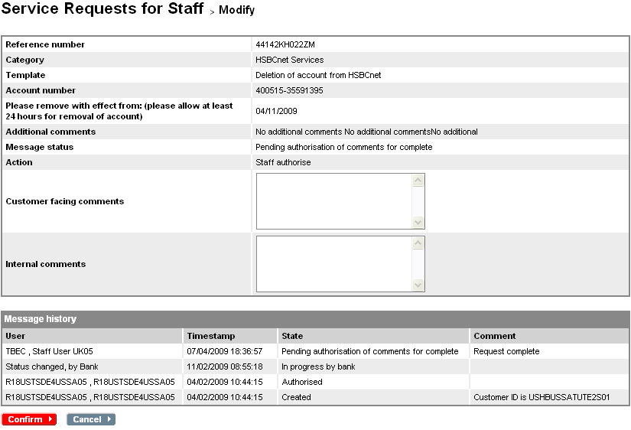
Service Request Details – Confirm Staff Authorise
After verifying the modifications made, click “Confirm” to proceed.

Slide 41
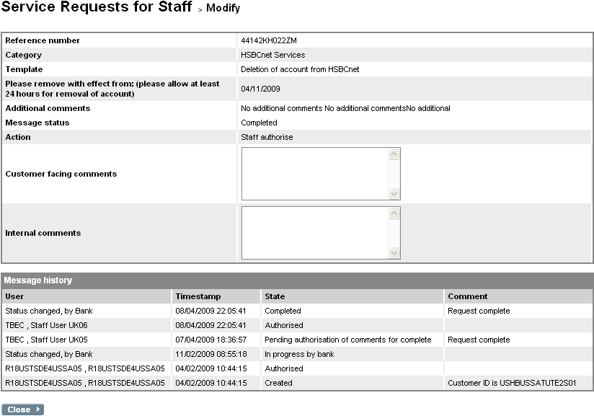
Service Request Details – Acknowledgement
Once confirmed, the “Message history” will be updated to reflect the new status, and the customer will be able to see any customer facing comments entered by the initiating staff user

